Slide 1
Low-Light
Image Enhancement
Techniques

Slide 2
Low Light Image Enhancement
Many photos are often captured under suboptimal lighting conditions due to inevitable environmental and/or technical constraints. These include inadequate and unbalanced lighting conditions in the environment, incorrect placement of objects against extreme back light, and under-exposure during image capturing
This affects viewers’ experience and leads to wrong message being communicated, such as inaccurate object/face recognition.
So I am going to discuss three types of Image Enhancement techniques
Zero-DCE(Deep Curve Estimation)
Single Backlit Image Enhancement
Prompt Learning for Unsupervised Backlit Image Enhancement

Slide 3

Zero-DCE
Here, we present a deep learning-based method, Zero-Reference Deep Curve Estimation (ZeroDCE), for low-light image enhancement
Zero-DCE is a purely data driven method and takes multiple light enhancement factors into consideration in the design of the non-reference loss functions, and thus enjoys better robustness, wider image dynamic range adjustment, and lower computational burden.
The key components in Zero-DCE, namely LE-curve, DCE-Net, and non-reference loss functions
Light-Enhancement Curve (LE-curve)
There are three objectives in the design of such a curve:
each pixel value of the enhanced image should be in the normalized range of [0,1] to avoid information loss induced by overflow truncation;
this curve should be monotonous to preserve the differences (contrast) of neighboring pixels; and
the form of this curve should be as simple as possible and differentiable in the process of gradient backpropagation.
DCE-Net
To learn the mapping between an input image and its best-fitting curve parameter maps, we propose a Deep Curve Estimation Network (DCE-Net). We employ a plain CNN of seven convolutional layers with symmetrical concatenation.

Slide 4
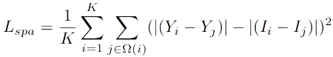
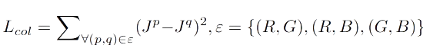
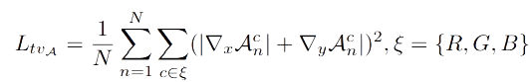
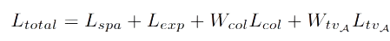
Non-Reference Loss Functions
The following four types of losses are adopted to train our DCE-Net
Spatial Consistency Loss.
The spatial consistency loss encourages spatial coherence of the enhanced image through preserving the difference of neighboring regions between the input image and its enhanced version:
Exposure Control Loss.
Exposure control loss, refers to the difference between the desired exposure level and the actual exposure level in an image
Color Constancy Loss.
we design a color constancy loss to correct the potential color deviations in the enhanced image
Illumination Smoothness Loss.
To preserve the monotonicity relations between neighboring pixels, we add an illumination smoothness loss to each curve parameter map

Slide 5
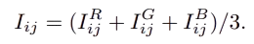
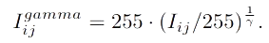
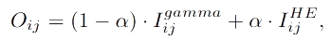
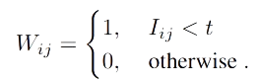
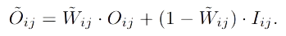
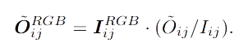
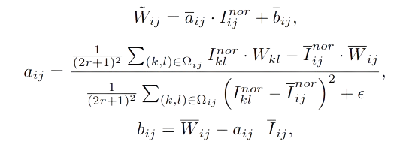
BACKLIT IMAGE ENHANCEMENT METHOD
Method
An enhanced intensity image with balanced intensity and contrast is first generated using gamma correction and histogram equalization in the proposed method.
Next, focusing on the intensity histogram of the backlit image, a binary image is created by Otsu’s method.
The edge-preserving smoothed version of this image is used as a weight map to suppress the artifacts at the edge parts.
Finally, an output image is obtained by alpha blending between the input image and the enhanced intensity image using the weight map
Guided Filter:

Slide 6
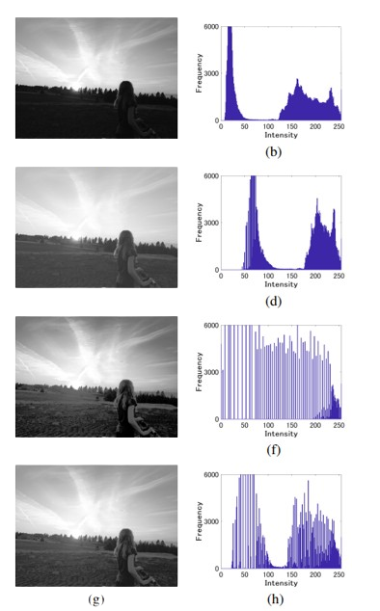
Processed backlit images and their histograms.
Intensity image I.
Result of gamma correction for I.
Result of histogram equalization for I.
Enhanced image obtained by alpha blending.

Slide 7
Unsupervised backlit image enhancement method, abbreviated as CLIP-LIT, by exploring the potential of Contrastive Language-Image Pre-Training (CLIP) for pixel-level image enhancement.
The approach consists of two stages, In the first stage, we learn an initial prompt pair (negative/positive prompts referring to backlit/well-lit images) by constraining the text-image similarity between the prompt and the corresponding image in the CLIP embedding space.
With the initial prompt pair, used a frozen CLIP model to compute the text-image similarity between the prompts and the enhanced results to train the initial enhancement network.
In the second stage, refine the learnable prompts by utilizing backlit images, enhanced results, and well-lit images through rank learning

Slide 8
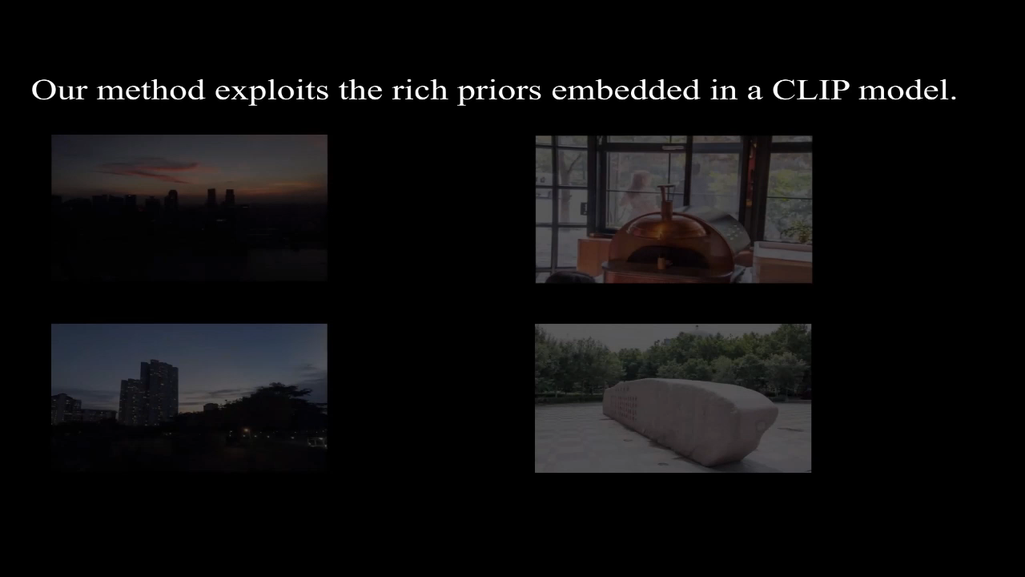

Slide 9
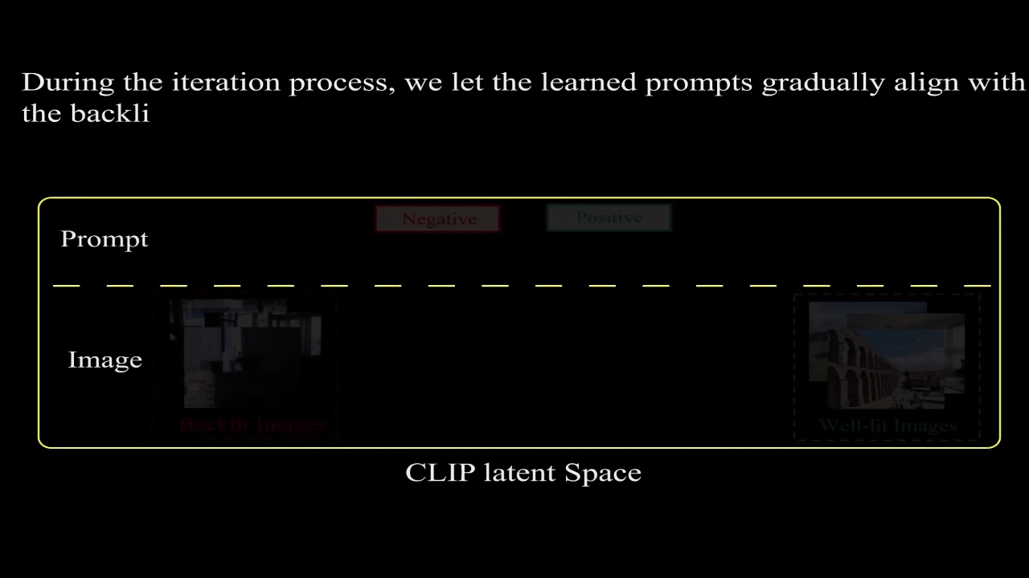

Slide 10
Results:
Image1(RRR)
Image2(Saitama)
Zero-DCE | Backlit Image Enhance | Prompt Learning(CLIP)
5.71dB | 22.76dB | 15.60dB
6.44 | 7.12 | 5.85
PSNR NIQE
Zero-DCE | Backlit Image Enhance | Prompt Learning(CLIP)
4.68dB | 17.12dB | 13.96dB
5.15 | 4.14 | 4.46
PSNR NIQE
PSNR NIQE

Slide 11
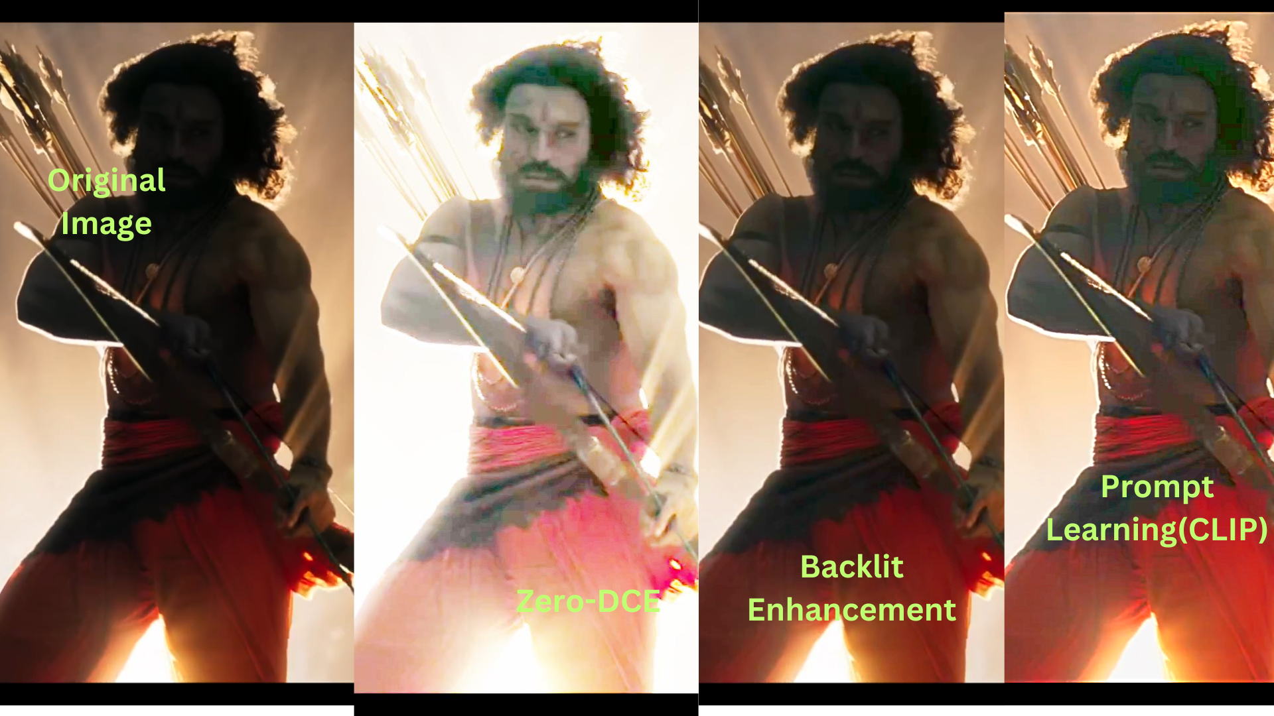

Slide 12
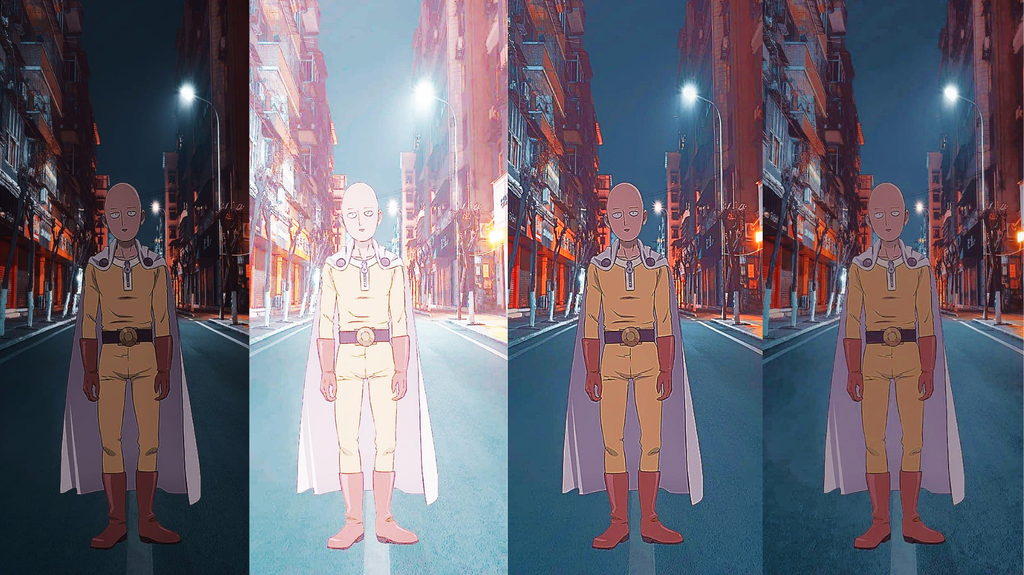

Slide 13
References
https://zhexinliang.github.io/CLIP_LIT_page/
https://github.com/HumanChwan/single-backlit-image-enhancement
https://keras.io/examples/vision
Code:
Part-1
CLIP
Singam Setty Deshik
2101AI32

